Slide 1




Bilgisayar Mühendisliği Bölümü
GTU CSE 496
GRADUATION PROJECT -2-
TURKISH TEXT CORRECTOR PLUGIN
ÇAĞRI ÇAYCI
ADVISOR: Dr. GÖKHAN KAYA
MARCH 2024
GTÜ - Bilgisayar Mühendisliği Bölümü
BİL 495/496 Bitirme Projesi
GTU COMPUTER ENGINEERING DEPARTMENT
CSE 496 GRADUATION PROJECT 2
Notes:
2

Slide 2

Contents
Review
Design Plan
Completed Tasks
Challanges and Reconsiderations
Future Plans
Requirements
Timeline
Success Criteria
Resources
GTU COMPUTER ENGINEERING DEPARTMENT
CSE 496 GRADUATION PROJECT 2
Notes:
2

Slide 3

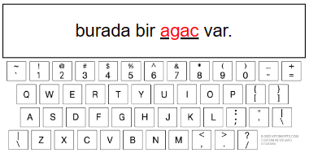
Review
Turkish Text Corrector Plugin is a browser extension intended to correct errors that arise when users type Turkish words using an English keyboard layout. This tool boosts typing accuracy and speed, especially for users who often need to type Turkish text but face limitations due to keyboard layout constraints.
GTU COMPUTER ENGINEERING DEPARTMENT
CSE 496 GRADUATION PROJECT 2
GTÜ - Bilgisayar Mühendisliği Bölümü
BİL 495/496 Bitirme Projesi

Slide 4
Design Plan
This project consists of 3 main steps:
Character Substitution: Substituting 'c' with 'ç', 'g' with 'ğ', 'i' with 'ı', etc.
Dictionary Lookup: Verifying words against a Turkish dictionary.
Proper Sentence Analysis: Composing the sentences using the most proper words and selecting most proper sentence.
GTU COMPUTER ENGINEERING DEPARTMENT
CSE 496 GRADUATION PROJECT 2
GTÜ - Bilgisayar Mühendisliği Bölümü
BİL 495/496 Bitirme Projesi

Slide 5
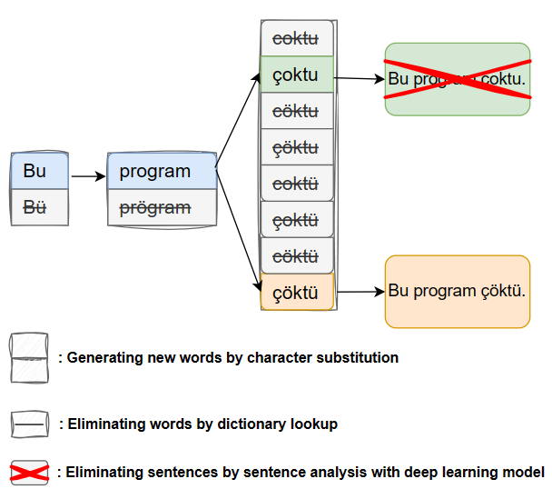
Design Plan
GTU COMPUTER ENGINEERING DEPARTMENT
CSE 496 GRADUATION PROJECT 2
GTÜ - Bilgisayar Mühendisliği Bölümü
BİL 495/496 Bitirme Projesi

Slide 6
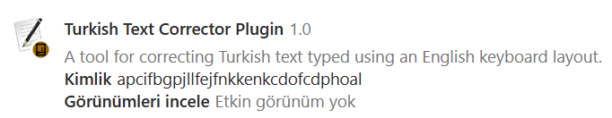
Completed Tasks
What things has been done so far;
A vocabulary dataset has been collected.
An extension capable of generating new words by character substitution and eliminating by dictionary lookup have been created.
A large dataset of sentences is gathered and cleaned.
Several deep learning models have been developed and tested, but they have failed.
GTU COMPUTER ENGINEERING DEPARTMENT
CSE 496 GRADUATION PROJECT 2
GTÜ - Bilgisayar Mühendisliği Bölümü
BİL 495/496 Bitirme Projesi

Slide 7
Challanges and Reconsiderations
The binary classification method aimed at selecting the most appropriate sentence for use in the project was ultimately not employed due to the absence of negative sentences.
Integrating a deep learning model into a browser extension poses a significant challenge.
The training process is time-consuming due to the extensive size of the dataset.
The process of generating new words through character substitution becomes increasingly time-consuming as the length of the word increases.
GTU COMPUTER ENGINEERING DEPARTMENT
CSE 496 GRADUATION PROJECT 2
GTÜ - Bilgisayar Mühendisliği Bölümü
BİL 495/496 Bitirme Projesi

Slide 8
Future Plans
What things are planned to do;
Utilize one-class classification in the deep learning model.
Train, test, and integrate the deep learning model.
Implement a mechanism to handle unseen words (those not present in the corpus).
The performance of extension will be evaluated using texts gathered from online forums, focusing on both time efficiency and accuracy.
GTU COMPUTER ENGINEERING DEPARTMENT
CSE 496 GRADUATION PROJECT 2
GTÜ - Bilgisayar Mühendisliği Bölümü
BİL 495/496 Bitirme Projesi

Slide 9
Requirements
To complete this project, some of the requirements are;
A web extension must be created that can read and modify text within text areas.
A Deep Learning Model must be developed and trained with Turkish sentences to select proper sentence.
The plugin must be tested with trivial (“bugun”) and non-trivial (“cig”) cases.
GTU COMPUTER ENGINEERING DEPARTMENT
CSE 496 GRADUATION PROJECT 2
GTÜ - Bilgisayar Mühendisliği Bölümü
BİL 495/496 Bitirme Projesi

Slide 10
Requirements
To satisfy the requirements, the following steps will be
applied;
Web extension will be developed in JavaScript.
Extensive vocabulary for Turkish dictionary will be collected.
Dataset of sentence will be gathered to train deep learning model.
A Deep Learning Model will be developed in Python.
GTU COMPUTER ENGINEERING DEPARTMENT
CSE 496 GRADUATION PROJECT 2
GTÜ - Bilgisayar Mühendisliği Bölümü
BİL 495/496 Bitirme Projesi

Slide 11
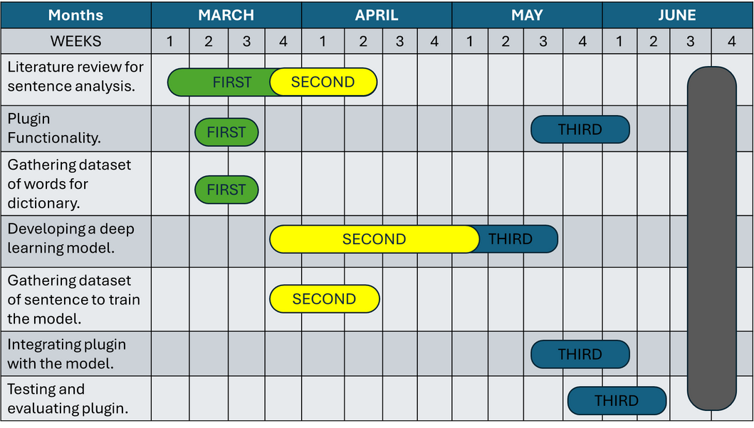
Timeline
GTU COMPUTER ENGINEERING DEPARTMENT
CSE 496 GRADUATION PROJECT 2
GTÜ - Bilgisayar Mühendisliği Bölümü

Slide 12
Success Criteria
Success criteria for the Turkish Text Corrector Plugin are;
Trivial Words Correction: Achieve a success rate of 100% for correcting trivial words which are in corpus.
Non-Trivial Words Correction: Achieve a success rate of 60% or higher in accurately correcting non-trivial words, which encompass words that may consist of multiple words or are absent from the corpus.
Timeliness: Find the incorrect words and make the necessary corrections within 3 seconds after the completion of the sentence.
GTU COMPUTER ENGINEERING DEPARTMENT
CSE 496 GRADUATION PROJECT 2
GTÜ - Bilgisayar Mühendisliği Bölümü
BİL 495/496 Bitirme Projesi

Slide 13
Resources
https://www.aarp.org/home-family/personal-technology/info-2022/web-browser-extensions.html [Browser Extension Image]
http://www.nyiniyu.com/?en_text-correction-and-translation,46 [Text Correction Image]
https://www.drawio.com/ [Design Plan Images]
GTU COMPUTER ENGINEERING DEPARTMENT
CSE 496 GRADUATION PROJECT 2
GTÜ - Bilgisayar Mühendisliği Bölümü
BİL 495/496 Bitirme Projesi

Slide 14
THANK YOU FOR LISTENING
GTU COMPUTER ENGINEERING DEPARTMENT
CSE 496 GRADUATION PROJECT 2
GTÜ - Bilgisayar Mühendisliği Bölümü
BİL 495/496 Bitirme Projesi

